Slide 1



Notes:
Insert Your Picture > Right Click > Send To back

Slide 2

The goal of RestoreHealth
BRIDGE THE GAP IN CARE BETWEEN VISITS
Creating healthier lives for a subset or your whole population
REDUCE HEALTHCARE COSTS
ENGAGE EMPLOYEES ON A PERSONAL LEVEL
CREATE LASTING HEALTH HABITS FOR LIFELONG RESULTS

Slide 3
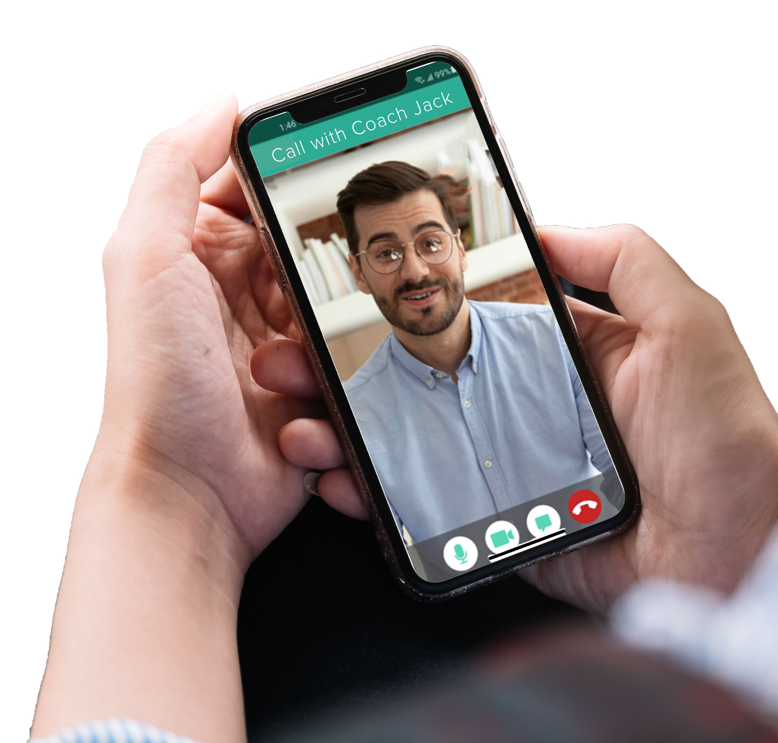
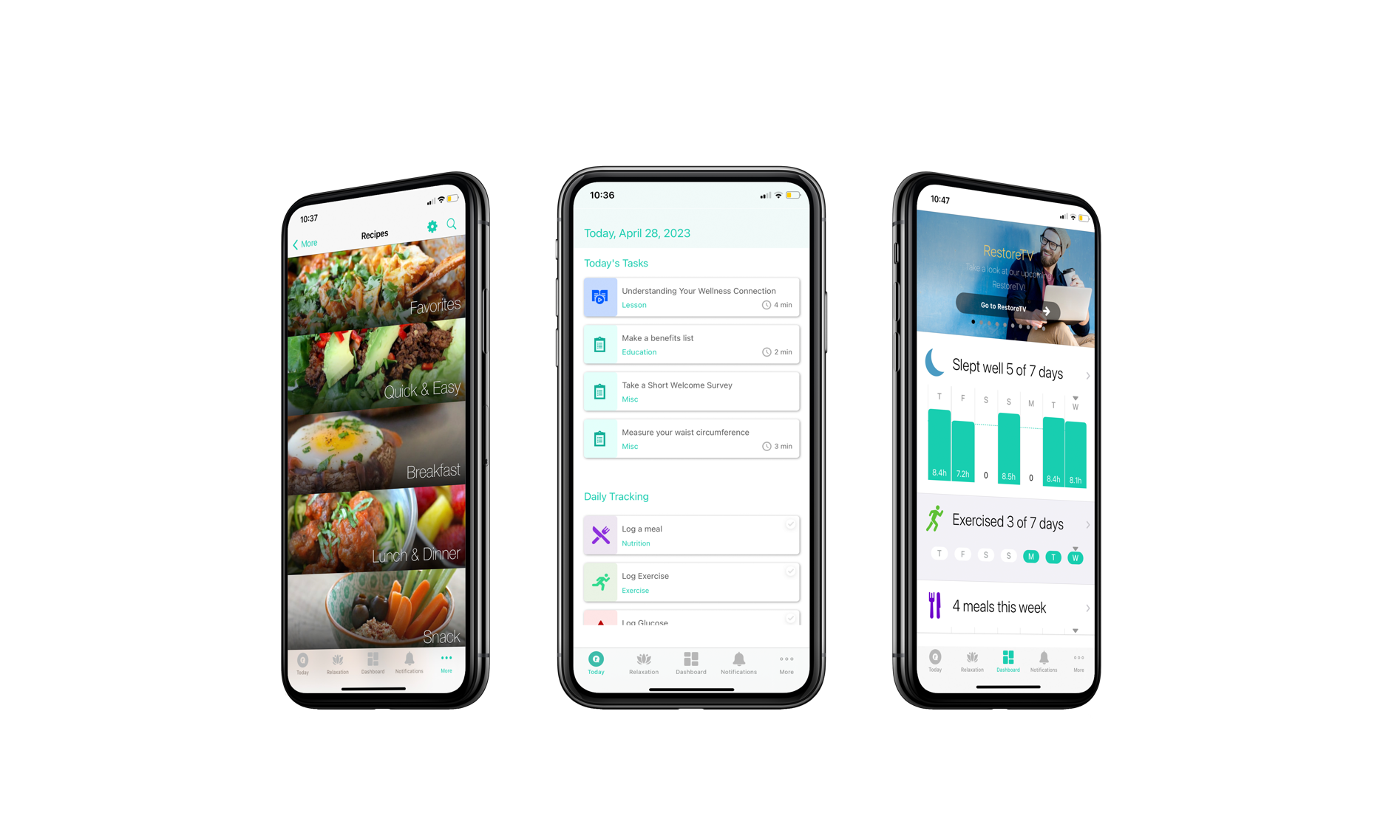
Introducing
RestoreHealth
One-on-one health coaching with calls and texts
Daily activities taking less than 5 minutes
Educational content in videos, articles, prompts
Tracking and progress reports on health factors
Relaxation and meditation activities
Personalized nutrition guide and library of recipes
Coach ratings on photo meal logs
Personalized exercise routine
Live coach-led webinars for additional education opportunities
Community board for social support
Notes:
SO many features of RH, and they’re personalized to the individual
With science-backed content and research proving effectiveness, RH helps your workforce be successful in reaching their health goals

Slide 4
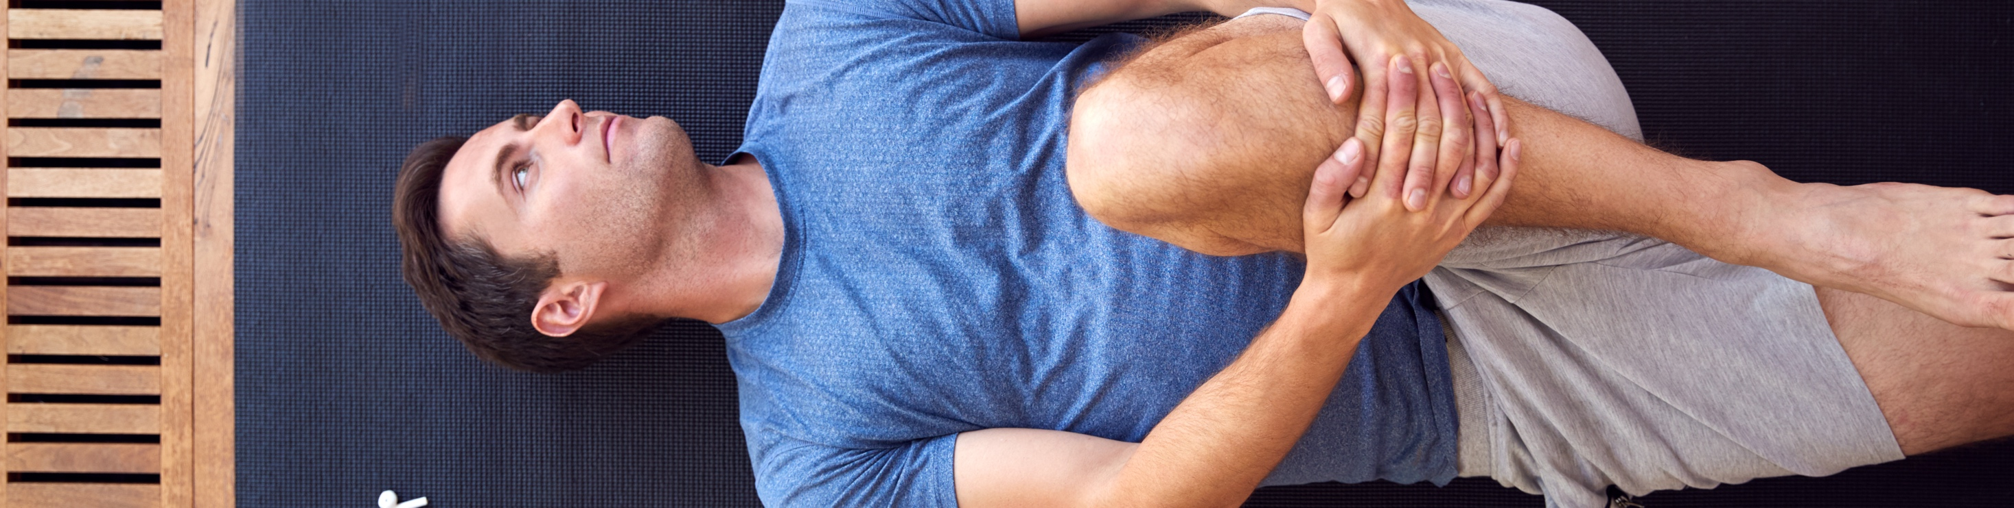
Why RestoreHealth really works
01
02
03
04
COACHING
ROOT CAUSES
BEHAVIORAL HEALTH
PERSONALIZED
Members are paired with a live health coach who works with them throughout their time on the program building person-to-person connections for enhanced support.
RestoreHealth addresses insulin resistance, the main factor in metabolic syndrome. It also personalizes the program to an individual’s needs, not one blanketed solution.
RestoreHealth doesn’t give advice on what to do. It gets deeper. The program and coaches address barriers to creating healthy habits and work with members to adjust their mindset for true, lasting change.
RestoreHealth works for all types of individuals. Through assessments and 1:1 conversions, the program provides a curriculum continually relevant to each person and their most pressing needs.

Slide 5

NUTRITION
EXERCISE
STRESS
SLEEP
4 pillars of health
Notes:
Our “4 pillars” of health
We believe that there are 4 pillars of health that are interconnected. Imagine these four areas of life are like a set of interlocking gears in a precision machine, such as a clock or engine. When the gears are each aligned and balanced, everything runs pretty effortlessly.
We also believe that wellbeing isn’t just limited to our physical health - but also our mental and emotional health. We take a holistic approach to health, and we know that our habits in the areas of nutrition, exercise, sleep, and stress matter.

Slide 6

4 PILLARS OF HEALTH
Nutrition
BALANCED EATING PATTERNS
We set an equal value to what you eat and to how you eat. Mindful eating is our goal.
SCIENCE-BACKED NUTRITION
Whole foods: veggies & fruits, lean animal & plant protein, healthy fats, & fiber-filled carbohydrates: close to Mediterranean
MINDFUL EATING HABITS
Intuitive eating habits to help them create eating patterns that are individualized and health-promoting
Notes:
For nutrition, we want to be clear with members that nutrition is about two things: what you eat, sure, but also about how you eat. With so many members struggling with stress eating or emotional eating habits, we emphasize how important our eating habits are, beyond just what’s on our plate. Our formal position is:
“It is the position of RH to encourage our members to create nutritious and balanced eating patterns while also practicing health-promoting habits around how to eat.” - so this pulls equal focus to the what and the how!
“We emphasize eating whole foods with a focus on a wide array of vegetables and fruits, lean animal and plant protein, healthy fats, and fiber-filled carbohydrates.” - here we are simply laying out the what, what’s on the list, what foods are we encouraging.
“At RH, we teach our members how to practice mindful and intuitive eating habits to help them create their own eating pattern that is individualized and health-promoting”. - and here we are expanding on the how. Our approach to eating is personal, and we know that through mindful eating habits, members can find their own personal eating pattern that best suits them.

Slide 7
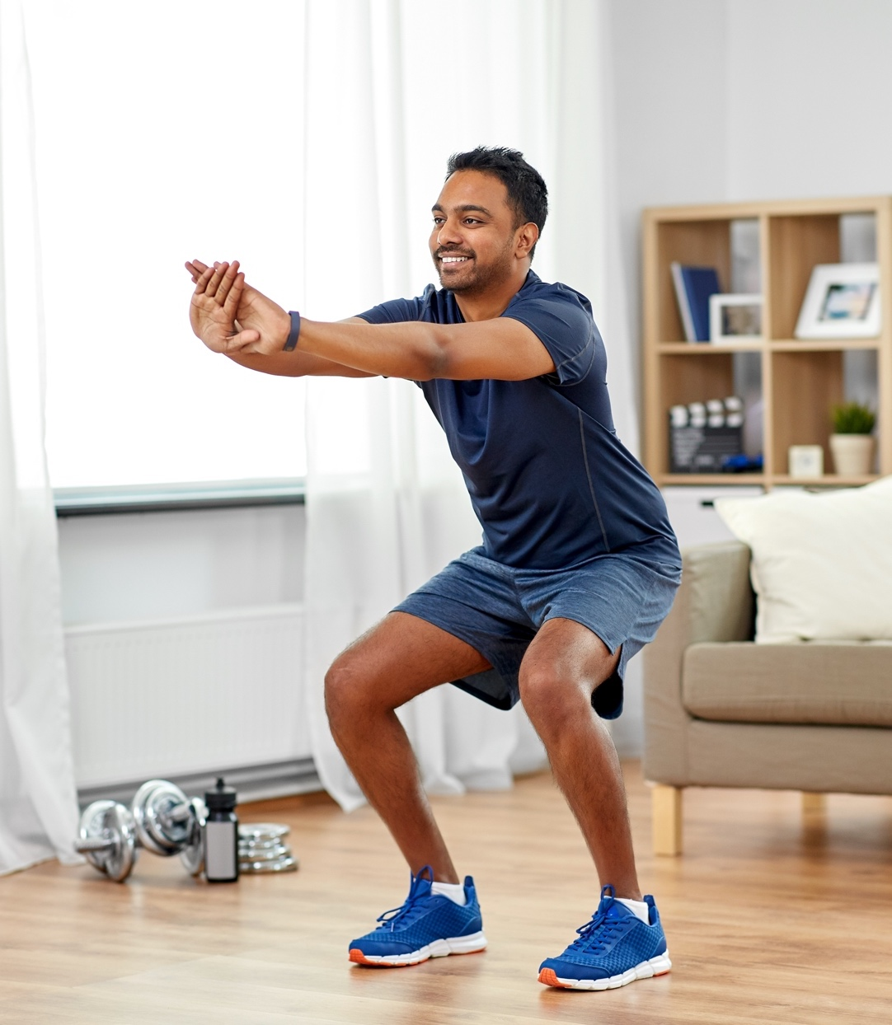
4 PILLARS OF HEALTH
Exercise
SCIENCED-BACKED CONTENT
Empower members to make exercises a daily habit by taking small steps to build consistency. We meet members where they are with personalized exercises.
EFFECTS ON HEALTH
Teach the impact on metabolic and cardiovascular health, immune function, mental health, and overall well-being.
MIX UP MOVEMENT
Encourage members to explore movement beyond exercise to counter the impact of a sedentary lifestyle.
Notes:
It is the position of RestoreHealth to encourage our members to approach exercise mindfully, considering the many benefits of making it a regular habit.
We teach members that exercise can positively impact metabolic health, immune function, mental health, and overall wellbeing.
We believe that exercise should be a daily habit, and encourage small steps to build consistency. We meet the member where they’re at, with personalized exercise levels and workouts as short as :30.
We encourage members to explore movement beyond exercise to counter the impact of a sedentary lifestyle.

Slide 8

4 PILLARS OF HEALTH
Stress management
BUILD RESILIENCE
There will always be life stressors, so we teach how to manage stress by building resilience and learning to reframe negative thoughts.
SCIENCE-BACKED CONTENT
Teach on the topics of self-care, self-awareness, mindfulness, positive relationships, and purpose.
POSITIVE RESPONSES
Help members learn to respond positively and confidently to challenges as they arise.
Notes:
It is the position of RestoreHealth to encourage members to manage stress through building resilience and learning to reframe negative thoughts.
We teach members to build resilience through self-care, self-awareness, mindfulness, positive relationships, and purpose. Our content is derived from scientific literature in transtheoretical model of behavior change, positive psychology, and coaching theory.
We equip members to respond positively and confidently to challenges as they arise.

Slide 9

4 PILLARS OF HEALTH
Sleep
THE FOUNDATION
All habits are built on sleep. It is the foundational element of health and affects nutrition choices, stress, and exercise.
SCIENCE-BACKED CONTENT
Teach on importance of 7+ hours / night, & that too little sleep can have an adverse effect on their mental, emotional, & physical health.
SLEEP HYGIENE
Help members create a consistent nighttime routine with a relaxing environment to improve sleep quality & quantity.
Notes:
It is the position of RH to encourage our members to approach sleep as the foundation upon which all habits are built.
We emphasize the importance of getting 7 or more hours of sleep nightly, and that too little sleep can have an adverse effect on their mental, emotional, and physical health.
We teach members to practice good sleep hygiene through consistent nighttime routines and by creating a relaxing environment.

Slide 10
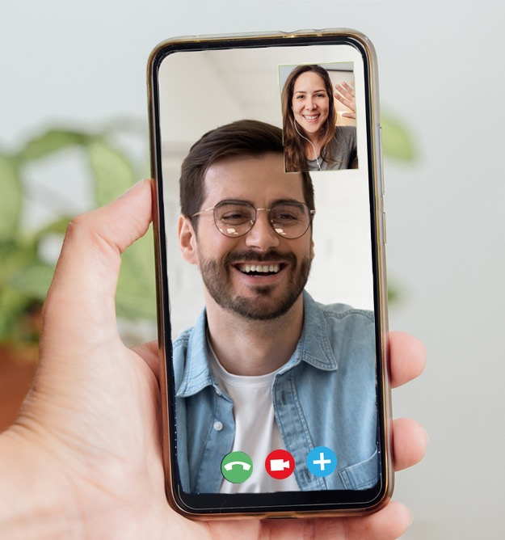


Human problems need human intervention
If your employees could do it alone,
they’d already be healthy.
They need more. They need the human touch.
Notes:
Regular apps work for people who are self-sufficient go-getters. We are after the people that need the extra help – the majority. The costly people. The ones who can’t do it on their own.
IF THEY COULD DO IT ALONE, THEY’D ALREADY BE HEALTHY… most people need the extra accountability, encouragement, and push!
“Participants reported that benefits of coaching included improved productivity, job motivation, people management skills and work life balance.”
- https://cdn2.hubspot.net/hubfs/226537/Blog%20files/Positive_psychology_and_coaching_psychol.pdf

Slide 11
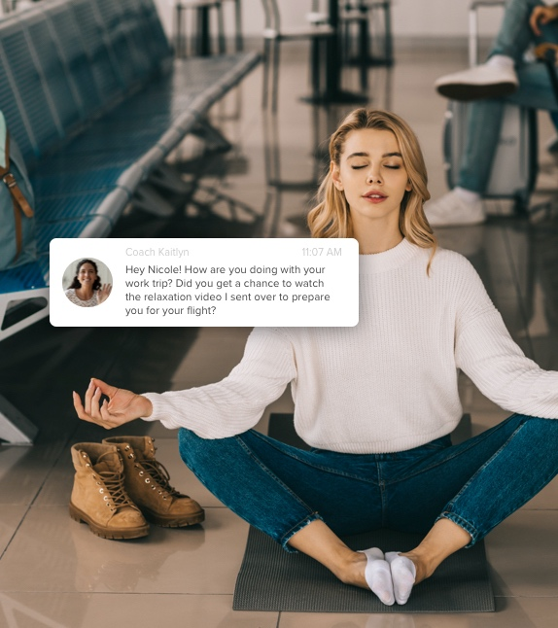
BENEFITS OF HEALTH COACHING
Personal health through personal care
PERSONALIZATION
Change content based on member needs and preferences
ENCOURAGEMENT
Provide positive, action-based advice for decision-making
ENGAGEMENT
WE ARE EXPERTS
Improve participation & use of app
Science-backed coaching methods
High caliber, National Health and Wellness Certified
Behavioral Health Coaching Certified
Credentialed to train other coaches for certification
ACCOUNTABILITY
Keep members accountable to their efforts and actions
EXPERT CARE
Guide members to analyzation and steps for growth
Notes:
Personal health through personal care
{click} coach credentials. “There are coaches, and then there are coaching EXPERTS”

Slide 12


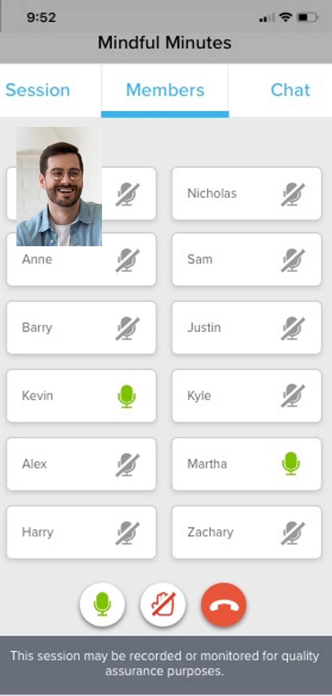
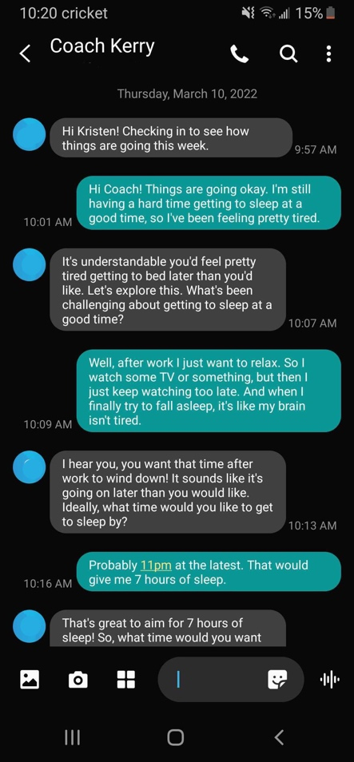
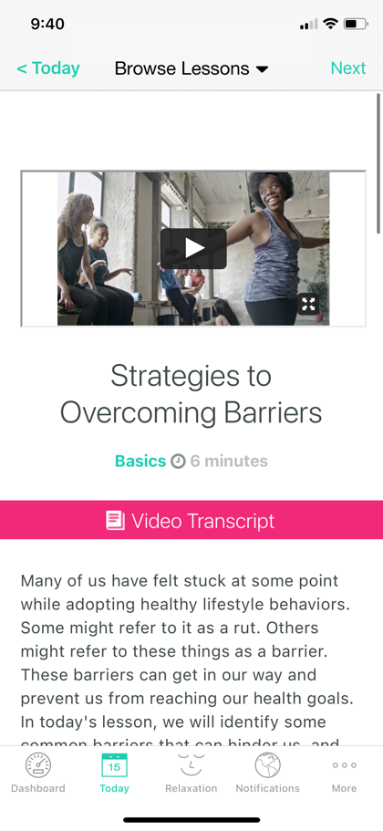
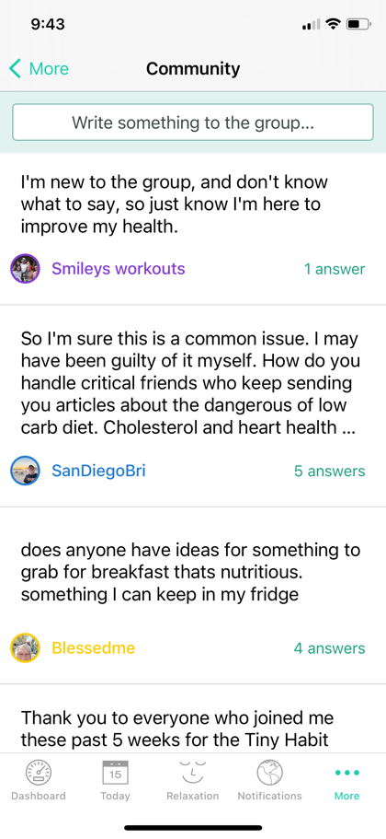
COACH INTERACTIONS
Real, personal, impactful
100%
of engaged members text or call their coach
at least weekly
1:1
CALLING
GROUP
COACHING
1:1
TEXTING
CUSTOMIZING CURRICULUM
COMMUNITY PARTICIPATION
Notes:
Here are a few ways our coaches interact with members.
ONE coach for an entire member journey – they follow members, learn their habits and create relationships for maximum results.
[CLICK] 100% of engaged members text or call their coach at least weekly - stress survey

Slide 13

GOOD FOR YOUR EMPLOYEES. GOOD FOR YOUR BUSINESS.
Business benefits
REAL, LASTING RESULTS
1
3
INCREASE EMPLOYER SATISFACTION
RestoreHealth boasts 6% weight loss in
addition to other improved biometrics. With a program that provides relevant, science-backed content and reduces barriers to change,
member create life-long healthy habits.
Providing employees with tools that continually meet their needs, they are more likely to respect their employer– minimizing turnover and increasing productivity.
REDUCED HEALTHCARE COSTS
2
4
INCREASED WORK ETHIC
As employees get healthier, they require less medical intervention. That means a reduction in ER visits, medications, and health-related interventions.
.
Healthier employees perform better at work. With their health issues improved, employees on RestoreHealth can show up for work, produce quality work, and be present in mind and body.

Slide 14

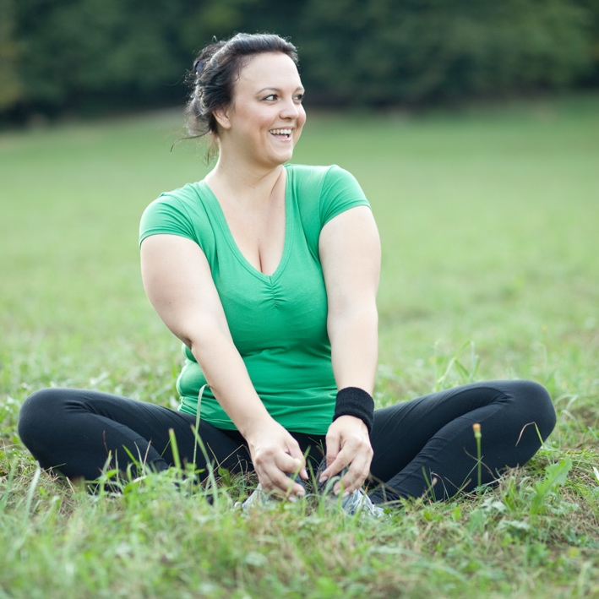

Improving employee health, one person
at a time.
CONTACT US TODAY
jennifer@healthfleet.com

